Slide 1

Hello And Welcome To MY Presentation
Self Introduction
ASHBA ATTAULLAH

Slide 2

About Me
My name is Ashba Attaullah. I recently completed My Matriculation in science and am now pursuing my First Year in Pre-Medical Studies. My goal is to become a doctor and serve humanity with knowledge and compassion.

Slide 3


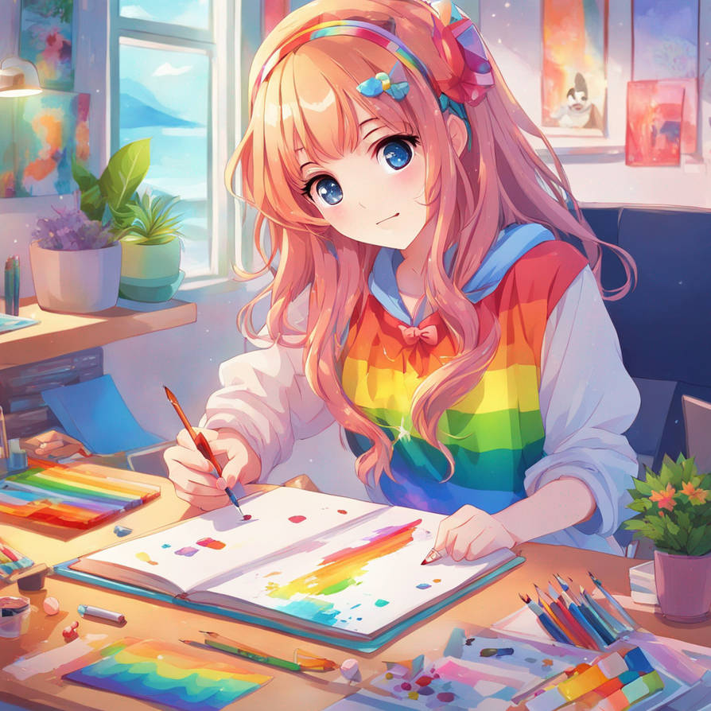
Hobbies
EDITING
Exploring New Technologies
DRAWING

Slide 4
Course Learning
Favorite Topic
Phyton
The CIT course helped me develop proficiency in MS Word, Excel, and PowerPoint, enabling the creation of certificates, marksheets, attendance sheets, and presentations. I also gained hands-on experience with Git, GitHub, and other essential software, strengthening my technical skills and project management abilities.
It lets me develop logical solutions, automate tasks, and apply problem-solving creatively in real-world projects.
Favorite Tool
Power Point
It allows me to create visually engaging presentations, organize information clearly, and communicate ideas effectively.

Slide 5
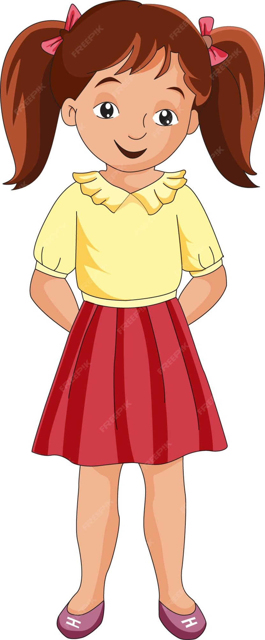
Personality Traits
Positive Personality Traits
Negative Personality Traits
Strong Work Ethic
Positive Problem Solver
Respect For Others
Eager To Learn
Creative Idea Maker
Perfectionist
Struggles with Focus

Slide 6



Future Goals
Role Model and Inspiration
Short Term Goals (1 year)
Bibi Fatima (RA)
Improve Skills
Build Confidence In Public Speaking
“Seek contentment with what God provides, and you will find peace.”
Medium Term Goals (2 year)
Bibi Fatima (RA) is my role model for her honesty, humility, wisdom, and remarkable strength. Her character and values inspire me to approach challenges with integrity and resilience in both personal and professional life.
Gain Professional Certification
Long Term Goals
Become a Qualified Doctor

Slide 7


Academic Achievement
Personal Achievement
Secured 94% in Class 8 and awarded a medal for excellence
Enhanced Creative Skills Through Continous Practice And Learning
Certified in Digital Marketing upon successful course completion.
Improved problem-solving ability through critical thinking and practical application.
Successfully completed Matriculation.
Built confidence in public speaking.

Slide 8
Strength and weakness
STRENGTH
Weakness
S
W
Responsible & Honest
Quick Learner
Creative Thinking
Goal-Oriented
Nervous IN Public Speaking
Perfectionist

Slide 9

Fun Fact About Me
I get excited about learning something new every day.

